Slide 1
Subject to follow
Dear colleagues,
How are you? I think you are well & good. I would like to request you to read the notes in normal mood carefully below the ‘Click to add notes’ option to conduct the class spontaneously. If you think any change to take the class more effectively, you can do that. In case of any inquiry please call 01556652300.
Your near and dear
Md. Hasan Hafizur Rahman
Content developer (English)
Cambrian School & College
Dhaka.
Notes:
Teacher may read the instructions carefully before going to the class.

Slide 2
Welcome to the world of HHR multimedia presentation.
Notes:
Welcome slide. Teacher may change it .

Slide 3
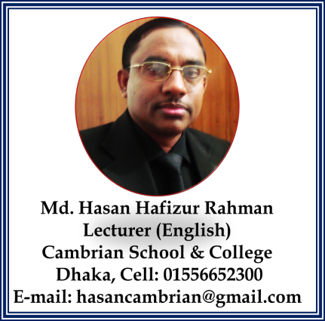
Introduction of the teacher & class
English For Today
Class-IX-X
Notes:
Introduction of teacher & Class.

Slide 4
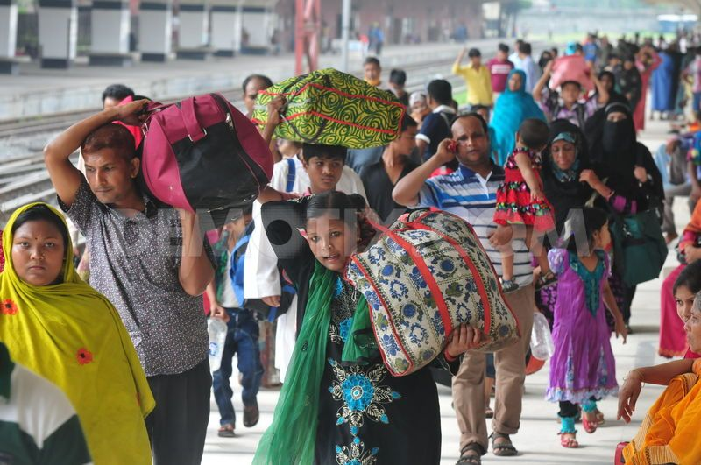
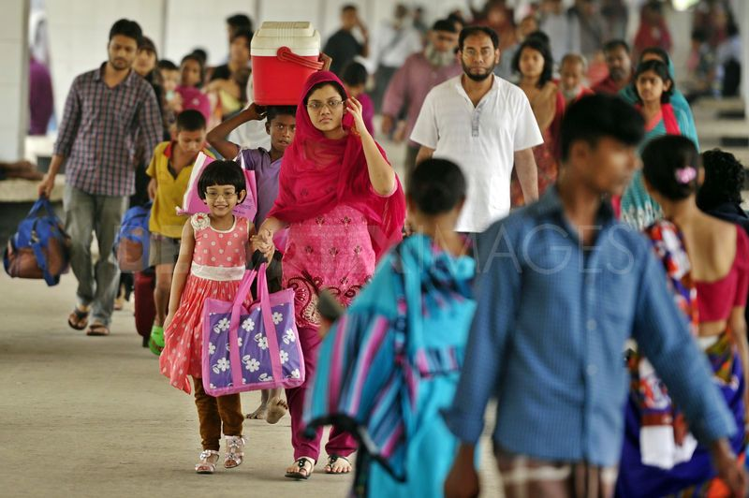
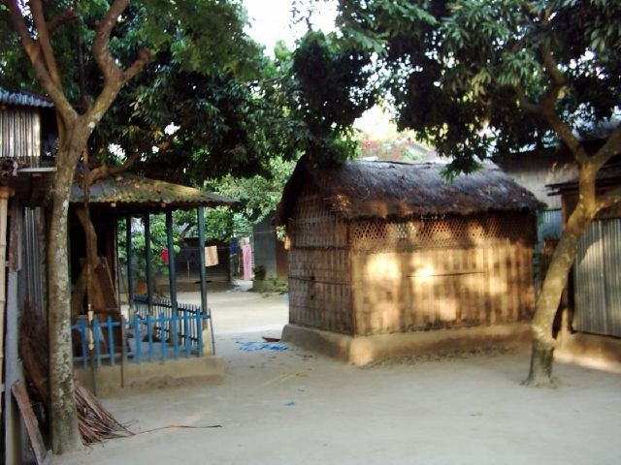
What do you mean?
to
People returning home/village/native
Notes:
Leading to lesson declaration.

Slide 5
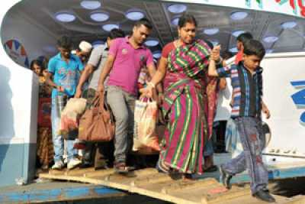
Our today’s
lesson is
Return of the native
Unit-12, Lesson-3
Notes:
Lesson declaration.

Slide 6
Learning outcomes
After studied this lesson, we will be able to –
ask and answer questions
read and understand the text through silent reading
work in pairs to relate the theme to roots
Notes:
All the four skills of English will be focused.

Slide 7
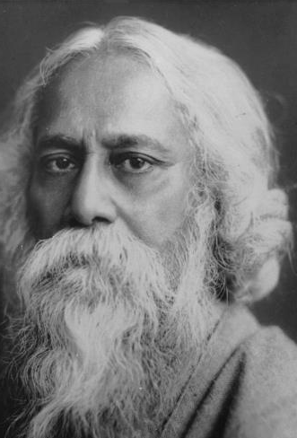
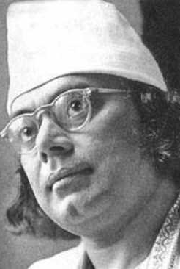
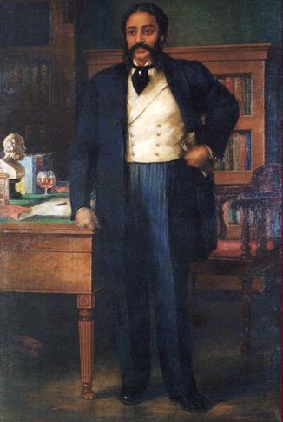
Do you know them?
Notes:
Leading to topic.

Slide 8
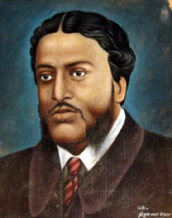
Who composed Sonnet among them?
Michael Madhusudan Dutt
Notes:
Introduction of Michael Madhusudan.

Slide 9
Let us know something about Michael Madhusudan Dutt in a video.
Notes:
Madhusudan at a glance.

Slide 10
was born in Sagardari, Keshobpur, jessore, on the bank of Kopotaksha river.
Raj Narayan
Dutt (Father)
Michael Madhusudan Dutt
He was born in a sophisticated ‘Hindu Family’.
Bengali poet & Dramatist
He took Christianity to pope Diltri on 13 February 1843.
Jahnabi Devi (Mother)
Pope Dilrti named him ‘Michael’.
He breathed his last on 27 June 1873 three days after the death of Henrietta.
Notes:
A short life history of Michael. Henrietta is hyperlinked. You can show Henrietta clicking the word.

Slide 11
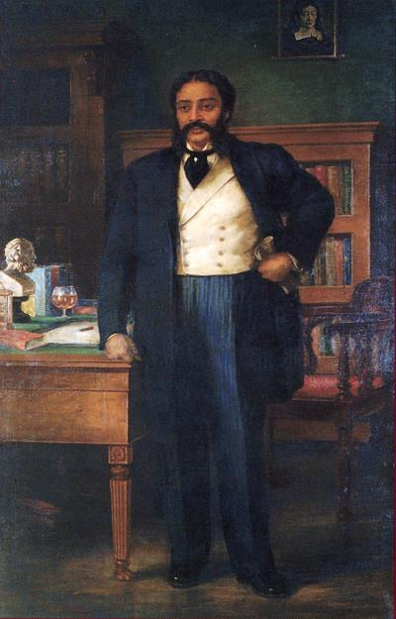
I believe that I was born on the wrong side of the planet, and that my society is unable to appreciate my intellect. The west would be more receptive to my genius.
Notes:
His thinking since adolescence.

Slide 12
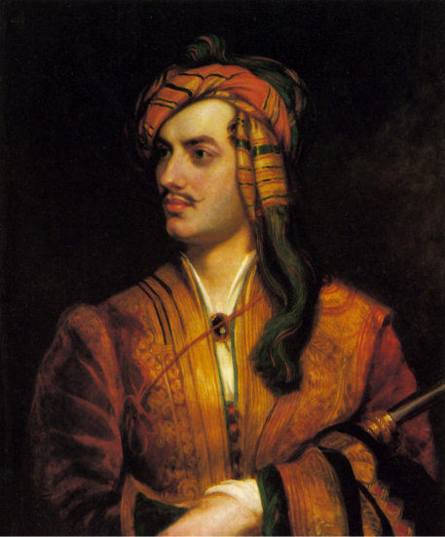
was an ardent follower of-
Lord
Byron
Michael
Famous English poet
Notes:
He was led to English by Byron.

Slide 13
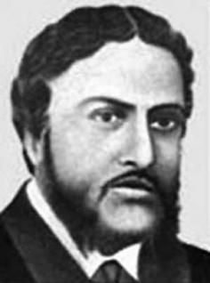
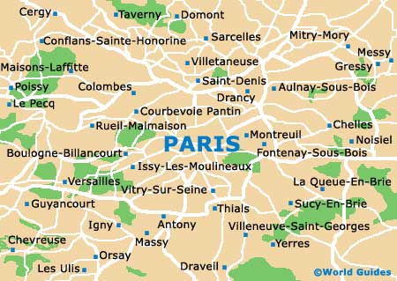
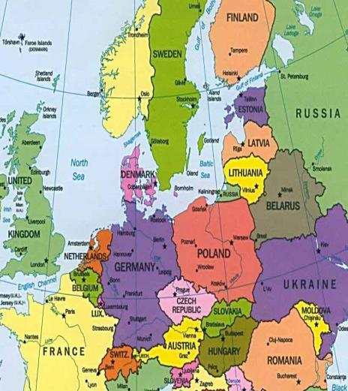
France
France
After adopting Christianity Michael went to --
Europe
Notes:
(Europe ,red rectangle box and red France are triggered) Click Europe, then red box, then blank click and see France in red, then click in red France. (বাংলায় Versailles-কে ভার্সাই নগরী বলা হয়)।

Slide 14
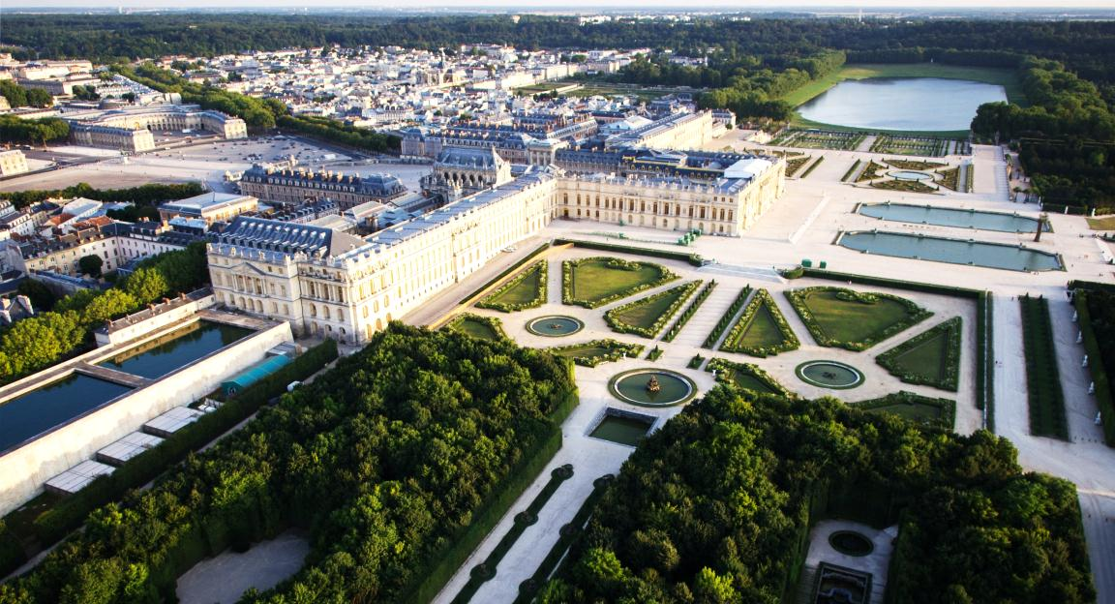
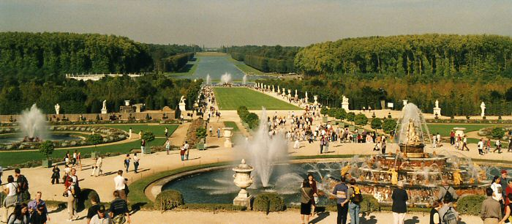
Versailles city
The poet lived in this city and composed his poetry and drama almost entirely in English.
Notes:
After going to Europe Michael started composing his works living in this city. (বাংলায় এই শহরকে ভার্সাই নগরী বলা হয়)।

Slide 15
No one accepted him and he failed to gain the right appreciation. To his utter frustration he found that he was not esteemed as a native writer of English literature.
Notes:
Michael got no positive feed back from Europe as an English writer and he got frustrated.

Slide 16
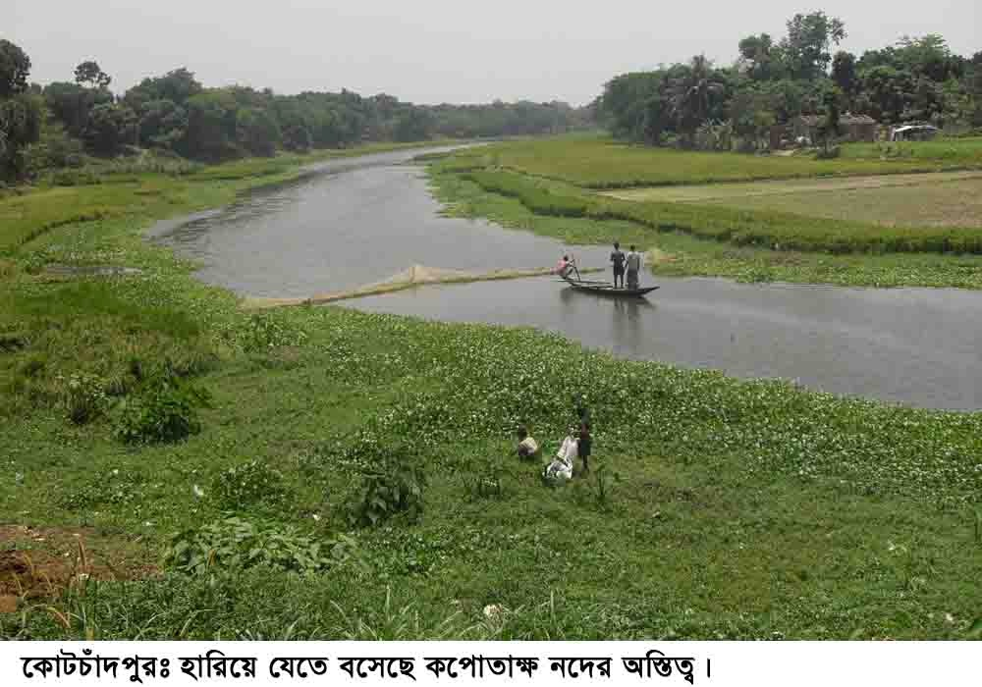
কপোতাক্ষ নদ
--মাইকেল মধুসূদন দত্ত
সতত, হে নদ, তুমি পড় মোর মনে!
সতত তোমার কথা ভাবি এ বিরলে;
সতত (যেমতি লোক নিশার স্বপনে
শোনে মায়া-মন্ত্র ধ্বনি) তব কলকলে
জুড়াই এ কান আমি ভ্রান্তির ছলনে!
বহু দেশ দেখিয়াছি বহু নদ-দলে,
কিন্তু এ স্নেহের তৃষ্ণা মিটে কার জলে?
দুগ্ধ-স্রোতরূপী তুমি জন্মভুমি-স্তনে।
আর কি হে হবে দেখা?– যত দিন যাবে,
প্রজারূপে রাজরূপ সাগরেরে দিতে
বারি-রূপ কর তুমি; এ মিনতি, গাবে
বঙ্গজ জনের কানে, সখে, সখা-রীতে
নাম তার, এ প্রবাসে মজি প্রেম-ভাবে
লইছে যে তব নাম বঙ্গের সঙ্গীতে।
Out of his frustration he composed-
Kopotaksha Nad
16
Notes:
When Michael failed in English, he became frustrated and came back to Bengal do something exceptional in Bengali. He composed ‘Kaopotaksha Nad’. (Sonnet-চতুর্দশপদী কবিতা)

Slide 17
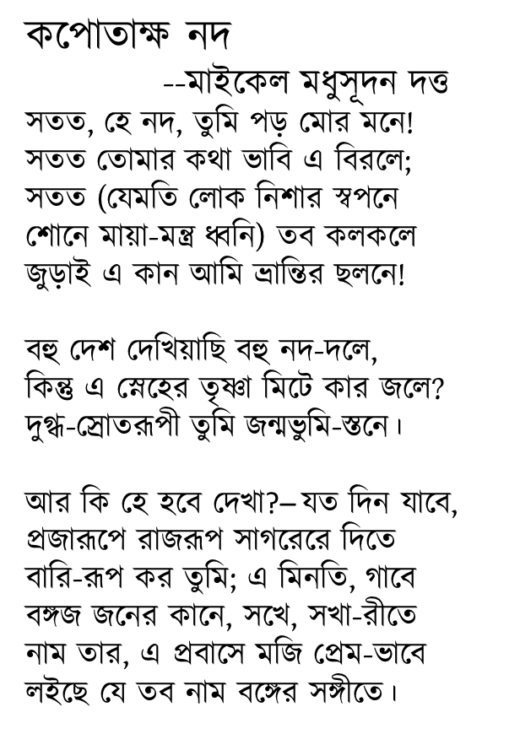
This poem earned him huge reputation in Bangla. Gradually he could realise that his true identity lay in Bengal and he was a sojourner in Europe. Afterwards he regretted his fascination for England and the West.
Notes:
Writing this poem he recovered his frustration and forgot the bitter experience of Europe.

Slide 18
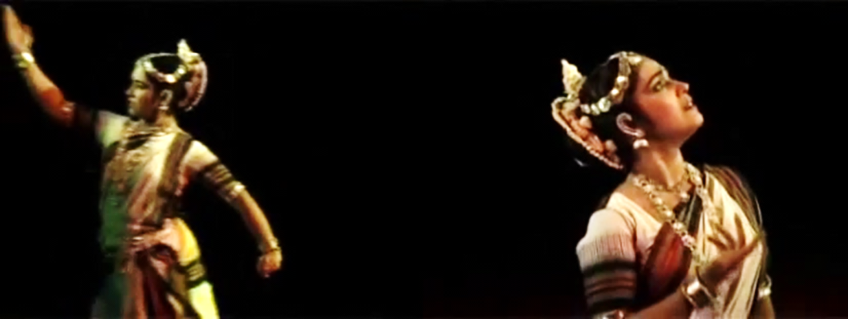
Michael Madhusudan is the writer who wrote the first Bangla epic
Meghnad Badh Kabya
Notes:
‘Meghnad Badh Kabya’ is the greatest works (রচনা) of Michael that has made him immortal in Bengali literature.

Slide 19
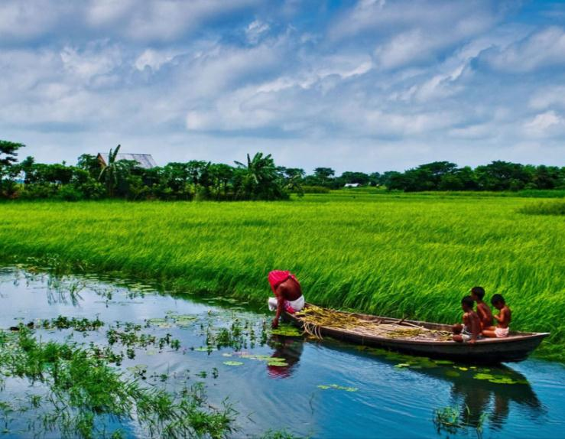
At last he returned to his native.
Bengal
Notes:
Bengal is triggered. Click Bengal to see a beautiful picture. By this slide it is meant ‘Return of the native’.

Slide 20
Hidden Slide
A portion of this topic is covered by this option. Trigger option is introduced here. To see the meaning, please click on the word.
Notes:
Before presentation, you are cordially requested to see the slides in normal mood.

Slide 21
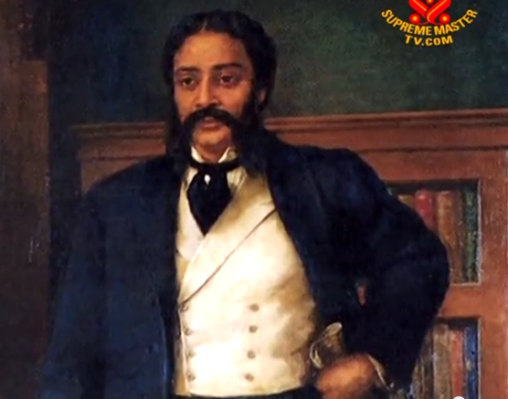
Let us know the Key words/new words to understand the topic clearly.
Dramatist
One who writes drama/ Author/
playwright
Michael Madhusudan Dutt was a Bengali poet and dramatist.
Notes:
The word is available. First ask the meaning, then click in blank space and show the picture, then click on the picture to show the sentence, at last you can click on the triggered word to show the meaning.

Slide 22
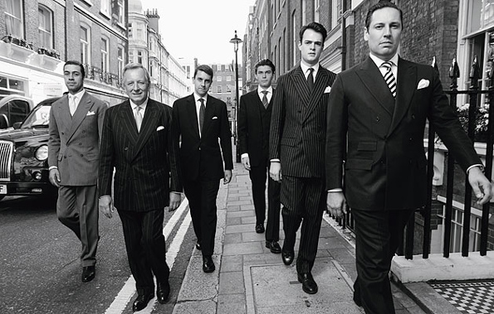
Aspired
One who desire something/ aimed/hoped
Dutt aspired to be an Englishman in form and manner.
Notes:
The word is available. First ask the meaning, then click in blank space and show the picture, then click on the picture to show the sentence, at last you can click on the triggered word to show the meaning.

Slide 23
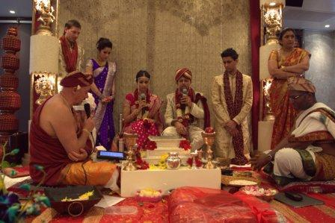
Sophisticated
Aristocratic,
high profile,
royal
Dutt was born in a sophisticated Hindu family.
23
Notes:
The word is available. First ask the meaning, then click in blank space and show the picture, then click on the picture to show the sentence, at last you can click on the triggered word to show the meaning.

Slide 24
Exposure
Interest,
Acquaintance,
Experience,
curiosity
His early exposure to English inspired him to be an English writer.
Notes:
The word is available. First ask the meaning, then click in blank space and show the picture, then click on the picture to show the sentence, at last you can click on the triggered word to show the meaning.

Slide 25
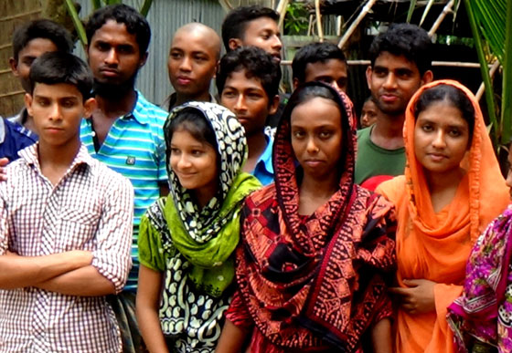
Adolescence
Youth,
Teen age years,
puberty
Human physical growth changes much in adolescent period.
25
Notes:
The word is available. First ask the meaning, then click in blank space and show the picture, then click on the picture to show the sentence, at last you can click on the triggered word to show the meaning.

Slide 26
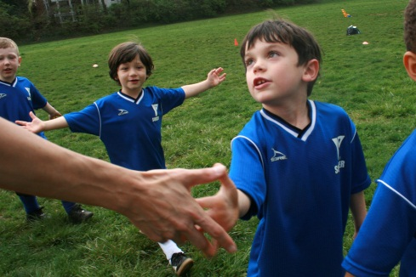
Appreciate
Praise,
Admiration,
consent
We should appreciate others’ success.
26
26
Notes:
The word is available. First ask the meaning, then click in blank space and show the picture, then click on the picture to show the sentence, at last you can click on the triggered word to show the meaning.

Slide 27
Receptive
Approachable,
Applicable,
Accessible
A good deed is always receptive to all.
27
27
Notes:
The word is available. First ask the meaning, then click in blank space and show the picture, then click on the picture to show the sentence, at last you can click on the triggered word to show the meaning.

Slide 28
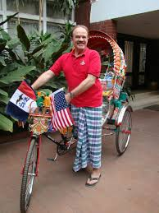
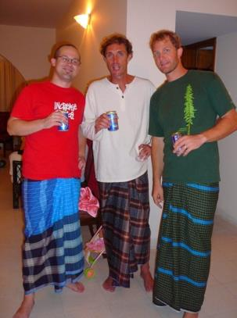
Sojourner
A person living in other country for the time being,
A foreigner.
Dan Mozena and the others in the picture are the sojourners in Bangladesh.
28
28
28
Notes:
The word is available. First ask the meaning, then click in blank space and show the picture, then click on the picture to show the sentence, at last you can click on the triggered word to show the meaning.

Slide 29
Note for the teachers
Teacher may conduct the rest of the lesson manually with text book, board, marker and other equipment.
Notes:
Just to continue relation with the text book, teacher may conduct manually from slide No 28-33.

Slide 30
A Read the following text to answer the following questions.
Michael Madhusudan Dutt was a popular 19th-century Bengali poet and dramatist. He was born in Sagordari on the bank of the Kopotaksha River, a village in Keshobpur Upozila under Jessore district. From an early age, Dutt aspired to be an Englishman in form and manner. Though he was born in a sophisticated Hindu family, he took Christianity as a young man, much to the ire of his family, and adopted the first name Michael. In his childhood, he was recognised by his teachers as a precious child with a gift of literary talent. His early exposure to English education and European literature at home and his college inspired him to imitate the English in taste, manners and intellect. Since his adolescence he started believing that he was born on the wrong side of the planet, and that his society was unable to appreciate his intellect. He also believed that the West would be more receptive to his creative genius. Michael was an ardent follower of the famous English poet Lord Byron. So after adopting Christianity, he went to Europe and started composing poetry and drama almost entirely in English. They proved his higher level of intellectual ability. However, he failed to gain the right appreciation. With his utter frustrations he saw that he was not regarded as a native writer of English literature. Out of his frustration he composed a sonnet in Bangla "Kopotaksha Nad", which earned him huge reputation in Bangla. Gradually he could realise that his true identity lies here in this Bengal and he was a sojourner in Europe. Afterwards he regretted his attraction for England and the Occident. He came to Bengal and devoted himself to Bangla literature from this period. He is the poet to write the first Bangla epic Meghand Badh Kabya.
Notes:
Teacher may ask the learners to open their text books to read silently to answer the questions in section B C & D. Text in the slide may be helpful to the teacher in any purpose. It is not mandatory to show it in the class.

Slide 31
B Work in pairs and decide how the story of Michael is related to the unit theme Roots.
C Read some more information on Michael. Make questions for those statements.
a. …………………………………………………………………….
He introduced amitrakshar chhanda (blank verse) in Bangla literature.
b. …………………………………………………………………….
Michael passed most of his European days in Versailles, France.
c. …………………………………………………………………….
His days in Europe were terrible.
d. …………………………………………………………………….
It was unbearable to him as he had to suffer extreme poverty.
e. …………………………………………………………………….
It was Iswar Chandra Bidyasagar who helped him to clear off his loans and
return to India.
Notes:
Text item. Teacher may go according to the text.

Slide 32
f. …………………………………………………………………….
Dutt married twice. While living in Madras, he married Rebecca Mactavys, of English descent.
g. …………………………………………………………………….
Later he married Henrietta Sophia White, who was also ethnic English.
h. …………………………………………………………………….
His second marriage lasted until the end of his life.
i. …………………………………………………………………….
Michael and Sophia had a son Napoleon and daughter Sharmistha.
j. …………………………………………………………………….
Dutt died in Calcutta General Hospital on 27 June 1873, three days after the death of Henrietta.
Notes:
Text item. Teacher may go according to the text.

Slide 33
D Write notes about Michael under the following headings. One example is given for you.
Michael as a man | Michael as a poet | Attitude to his roots
 | popular 19th century Bengali poet and dramatist
Notes:
Text item. Teacher may go according to the text.

Slide 34
May Allah bless you all.
Notes:
Ending slide.

Slide 35
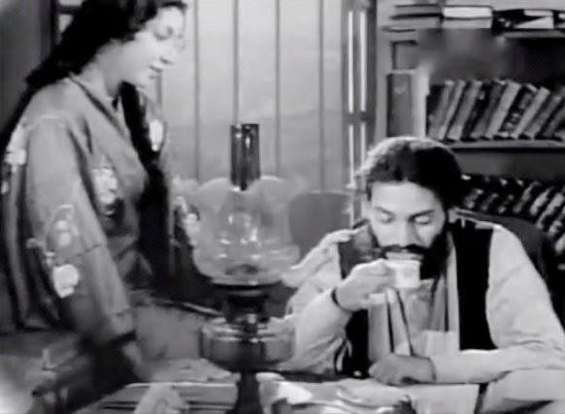
Michael with his wife Henrietta Sofia white
Notes:
In the third click you will see a play button. Click on the play button to return slide No.11.

